Slide 1
The Calendar doesn’t Lie!
It reveals the truth about your priorities

Slide 2

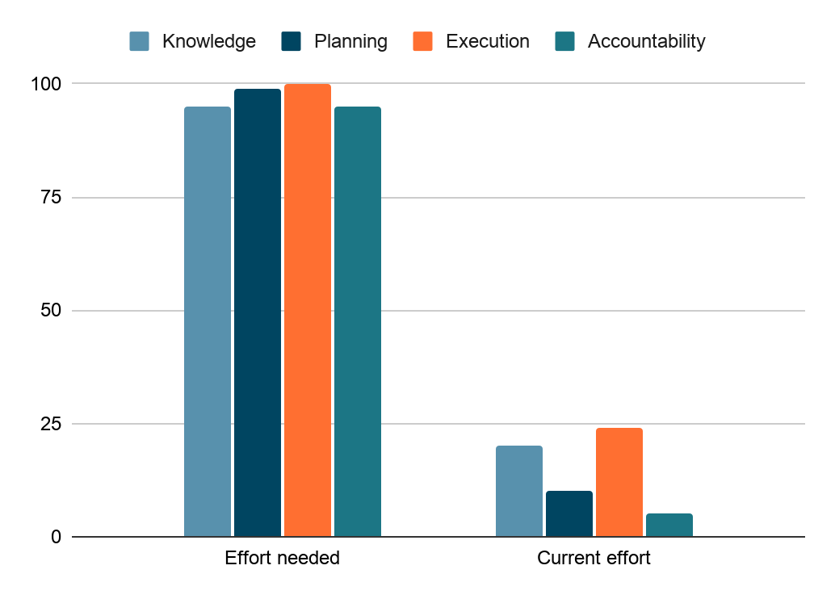
Have a Goal?
Notes:
I remember watching The Social Network back in 2010. I got so charged up — all I could talk about with my friends was starting something of our own. We'd sit around at lunch, brainstorming ideas, full of energy.
Slowly, that energy faded for most of the group — except for one friend and me. We were hell-bent on making it happen.
We finally landed on an idea, built a basic roadmap... and when it came to execution, we were all over the place. Six months in, we realized this took far more than we'd ever envisioned.

Slide 3
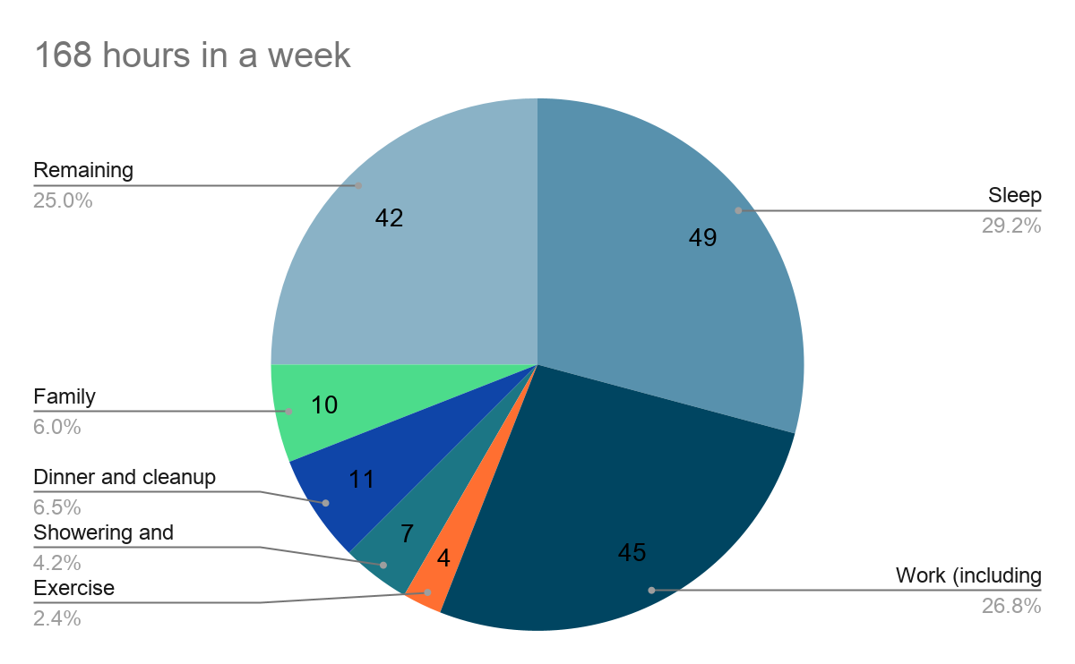
My Average week
EMBA
20 hours
Notes:
It starts with a goal. But not just the goal — you need to know your why, because that's what drives conviction and determination. Then you take a hard look at your calendar, and you carve out the time.
Let's try it right now. We're all here for our EMBA — how many hours a week do you think that actually takes? I estimated 20 hours, on a non-class week.
A week is 168 hours. Sleep takes 49. Work, including commute, 45. Exercise, 4. Showering and breakfast, 7. Dinner and cleanup, 11. Family, 10. That's 126 hours already spoken for.
That leaves 42.
And before this program, those 42 hours were already spoken for too — friends, outings, projects, golf, hobbies, just relaxing.

Slide 4
Decision
Reactive / Passive | Deliberate / Pro-active
Life happens to you | You happen to your week
React to deadlines | Sunday, 30 minutes
Scramble to deliver | Plan, then execute
Notes:
Now every one of us has to pull 20 hours out of that 42 — and we have to be strategic about what stays and what goes.
We have two options. We can be reactive — let life happen, react to deadlines, scramble to deliver. Or we can be deliberate — sit down every Sunday evening for 30 minutes, and plan the week ahead.
I know which one I'm choosing.

Slide 5
Open your calendar.
Block 30 minutes — tomorrow evening.

